Slide 1
Object Oriented Programming

Slide 2
Class Definitions
Class definition: set of statements that define a class’s methods and data attributes
Format: begin with class Class_name:
Class names often start with uppercase letter
Method definition like any other python function definition
self parameter: required in every method in the class – references the specific object that the method is working on (self is the equivalent of this operator in Java)

Slide 3
Class Definitions (cont’d.)
Initializer method: automatically executed when an instance of the class is created
Initializes object’s data attributes and assigns self parameter to the object that was just created
Format: def __init__ (self):
Usually the first method in a class definition ( Initializer method is the equivalent of the constructor in Java)

Slide 4
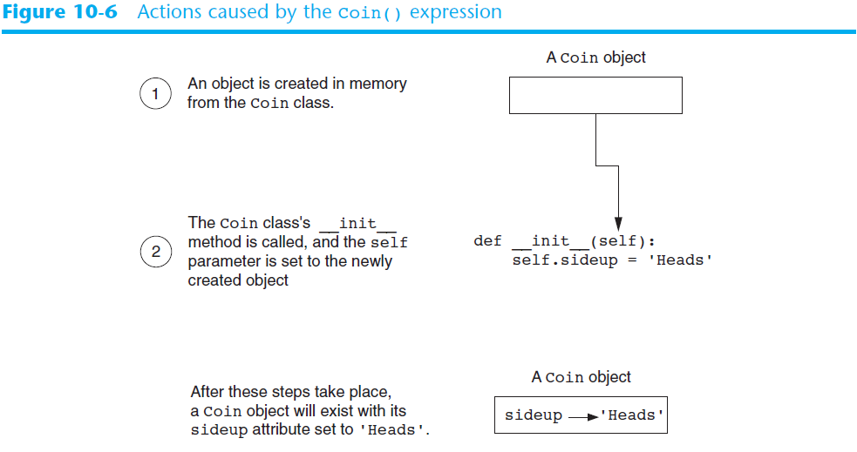
Class Definitions (cont’d.)

Slide 5
Class Definitions (cont’d.)
To create a new instance of a class call the initializer method
Format: My_instance = Class_Name()
To call any of the class methods using the created instance, use dot notation
Format: My_instance.method()
Because the self parameter references the specific instance of the object, the method will affect this instance
Reference to self is passed automatically

Slide 6
Hiding Attributes and Storing Classes in Modules
An object’s data attributes should be private
To make sure of this, place two underscores (__) in front of attribute name
Example: __current_minute
Classes can be stored in modules
Filename for module must end in .py
Module can be imported to programs that use the class

Slide 7

User-defined Classes
Each class we define will
Have a specified set of methods
Each object (instance) of the class
Will have its own value(s)
Class definitions have the general form

Slide 8
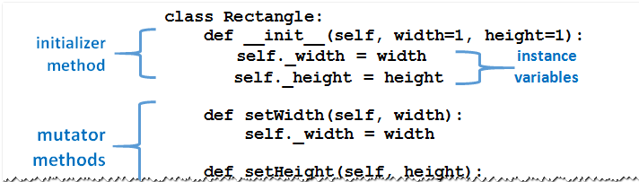
User-defined Classes
Methods defined much like ordinary functions
Methods have self as their first parameter.
Each method's self parameter references the object
A typical class definition.

Slide 9
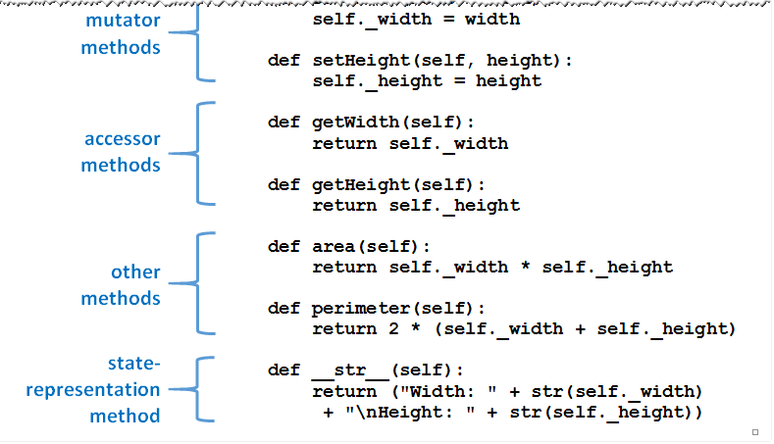
User-defined Classes
A typical class definition.

Slide 10
User-defined Classes
Classes are templates from which objects are created
Specifies properties, methods that will be common to all objects, instances of that class
Classes can be
Typed directly into programs
Stored in modules and brought into programs with an import statement

Slide 11
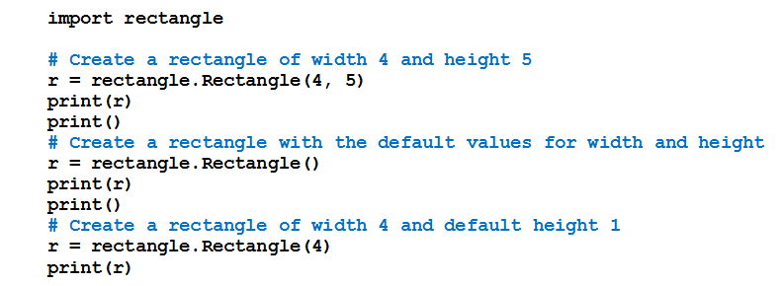
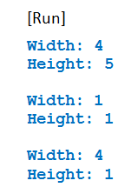
User-defined Classes
Example 2: Program shows effect of three different statements that create an instance of a Rectangle object

Slide 12
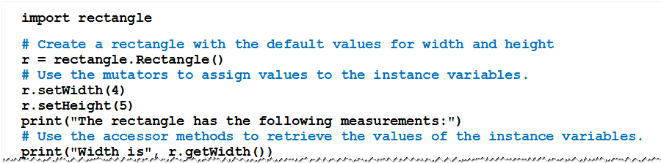
User-defined Classes
Example 3: Program uses Rectangle class methods to set, get measurements of rectangle

Slide 13
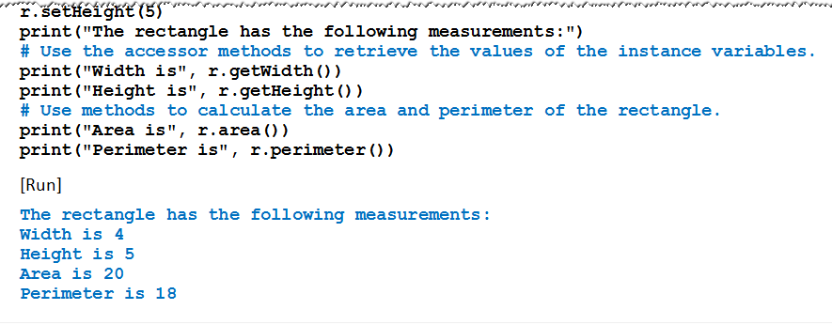
User-defined Classes
Example 3

Slide 14
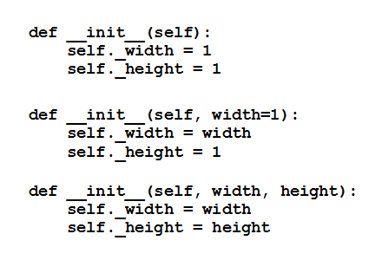
Other Forms of Initializer Method
Three other ways the initializer could have been defined
Third form, statement creating an instance must provide two arguments

Slide 15
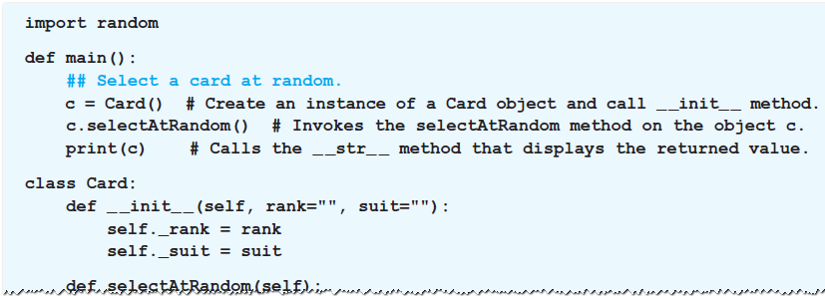
Number of Methods in a Class Definition
Class definitions can contain as many methods as desired
Example 4: Program uses a class containing no mutator or accessor methods

Slide 16
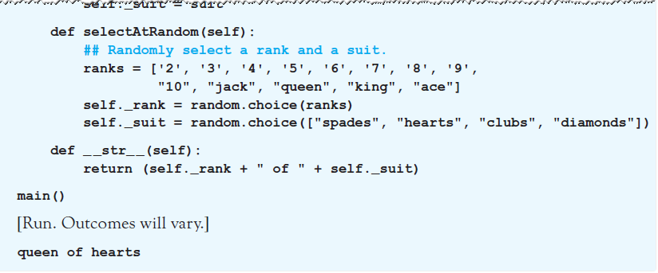
Number of Methods in a Class Definition
Example 4

Slide 17
Lists of Objects
Items of a list can have any data type
Including a user-defined class

Slide 18
END

